Slide 1





ALTERYX PROJECT REPORT
By Biplab Behera, Data Analyst
LinkedIn Profile: http://www.linkedin.com/in/biplab-behera

Slide 2
Problem statement Alteryx Weekly Challenge #298
For this challenge, I will be hosting the perfect Christmas night! I've invited friends over to eat cookies, listen to music, and watch a movie!
This is a two-part challenge: First I must choose each item (type of cookie, music and movie) based on a specific criterion that are in the container boxes below (I have opinionated friends), then I must use my 3 selections to find the key to the treasure box. The treasure box holds a special gift from your Weekly Challenge team!
(Hint: Label your final selection column as "Answer")
Dataset: Click here

Slide 3
Tasks
TASK 1:
Choose the cookie recipe that makes the most cookies!
1. You have 1000 grams of butter and 1000 grams of sugar.
2. The cookies recipes require the ingredients as listed.
3. You are not limited by any of the other ingredients.
TASK 2:
Choose a Christmas playlist for your guests while you eat cookies!
1. Assume each song is 3 minutes and that your total music playtime will be 45 minutes - this determines how many songs you have on the list!
2. Every song must be a -9 or lower in loudness (ex. -15 would be a very quiet song)
3. Eric wants all the minor songs and Matthew wants songs in F major.
4.Thalita loves Dean Martin!
5. Put the songs in order of loudness, so the music builds as a transition to the movie. The title of the last song is your "answer"!
TASK 3:
Movie Time!
You only want a movie that was released in the theatre
Nicole doesn't want to watch an animated movie.
Ryan is feeling nostalgic and wants to watch something from the 80's or 90’s.
It must be the top-rated movie of the year it debuted.
The movie with the longest run time in the Comedy genre is your "answer"!
TASK 4 :
After all that hard work to create the Best Christmas Evening Ever, use your three answers to find the key to the treasure box!
Use the provided lookup table to "find and replace” your answers to produce three sets of scrambled letters and numbers (hint: label column as "Answer").
Concatenate the key and add to the provided formula tool.
Once you run the key through the formula tool, you may open the treasure box and put the link in the tool configuration!

Slide 4
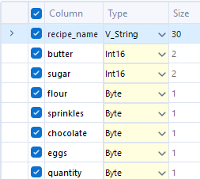
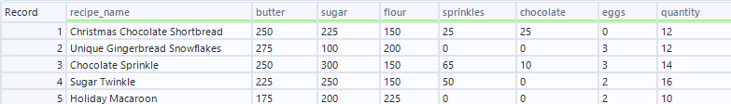
Task 1: Choosing the most efficient cookie recipe
Workflow Steps:
1. Data Quality Check: Started by ensuring data integrity using the Select Tool to verify correct data types & Filtered unnecessary columns using Data Cleansing Tool

Slide 5
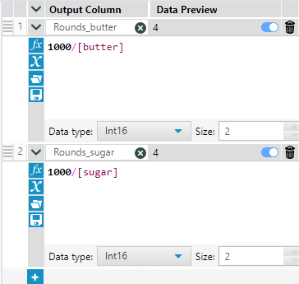
Task 1: Choosing the most efficient cookie recipe
Workflow Steps:
2. Calculations with Formulas: Utilized the Formula tool to calculate the number of rounds possible with available butter and sugar

Slide 6
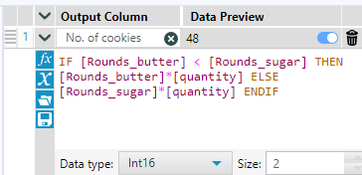
Task 1: Choosing the most efficient cookie recipe
Workflow Steps:
3. Optimizing Cookie Yields: Employed the following formula in the Formula Tool to determine the exact number of cookies each recipe could produce from available ingredients:

Slide 7

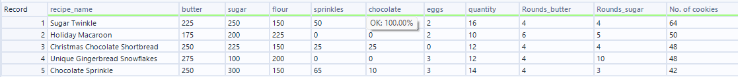
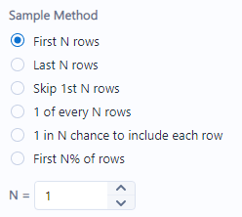
Task 1: Choosing the most efficient cookie recipe
Workflow Steps:
4. Sorting and Selection: Sorted the results in descending order of cookies using the Sort tool. Extracted the top row with the highest cookie yield using the Sample tool.

Slide 8

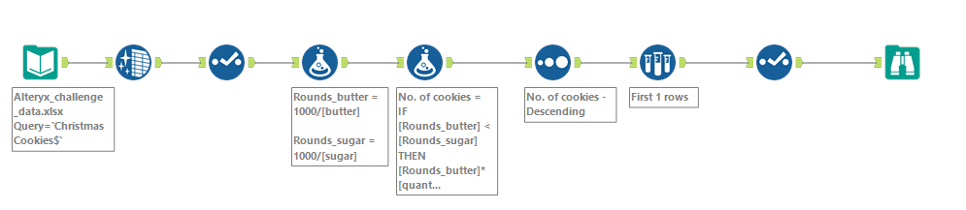
Task 1: Choosing the most efficient cookie recipe
Workflow Steps:
Result: After meticulous calculations and optimization, the winning recipe for the most cookies was "Sugar Twinkle" with an impressive yield of 64 cookies!

Slide 9
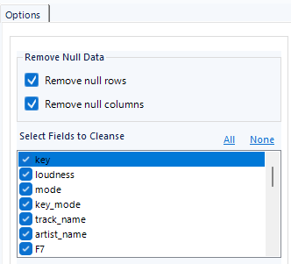
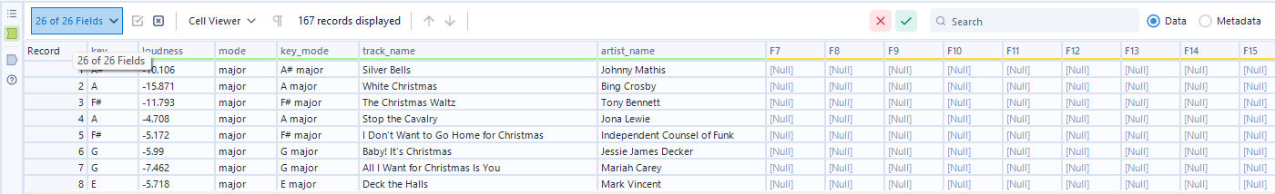
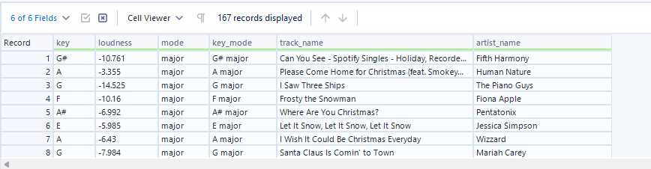
Task 2: To find the loudest music which fills all the criterions
Workflow Steps:
1. Data Quality Check: Filtered unnecessary columns using Data Cleansing Tool & Verified the dataset's integrity using the Select Tool to ensure correct data types.

Slide 10
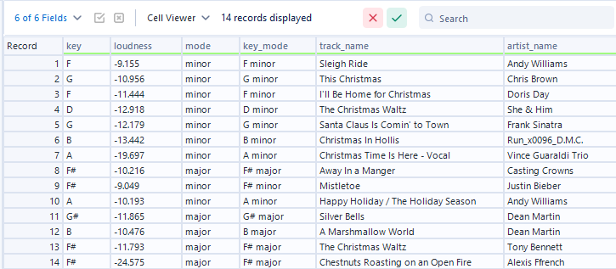
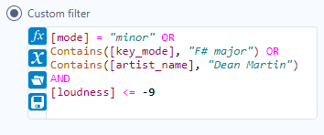
Task 2: To find the loudest music which fills all the criterions
Workflow Steps:
2. Filtering Relevant Records: Used the Filter Tool to narrow down the dataset with the following criteria.

Slide 11
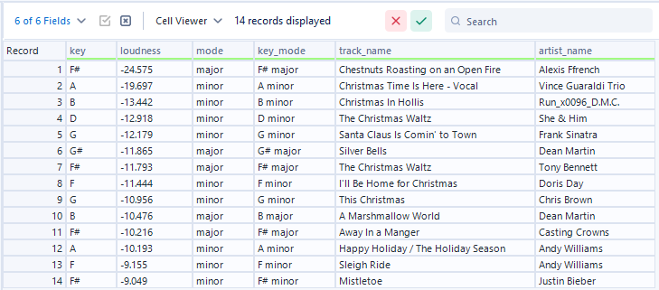

Task 2: To find the loudest music which fills all the criterions
Workflow Steps:
3. Sorting Records: Employed the Sort Tool to arrange records by loudness in increasing order.

Slide 12
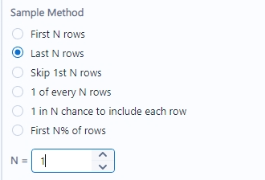

Task 2: To find the loudest music which fills all the criterions
Workflow Steps:
4. Selecting the Loudest Track: Utilized the Sample Tool to pick the 15th record, which happened to be:

Slide 13
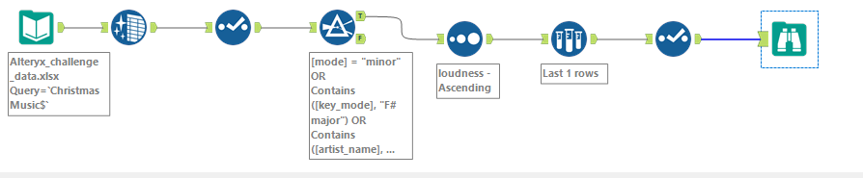

Task 2: To find the loudest music which fills all the criterions
Workflow Steps:
Results: With careful selection and analysis, the playlist gained its climax with Justin Bieber's "Mistletoe" as the loudest, setting the perfect festive mood!

Slide 14
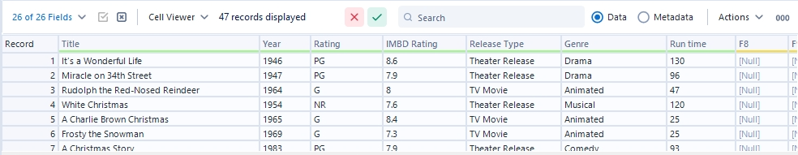
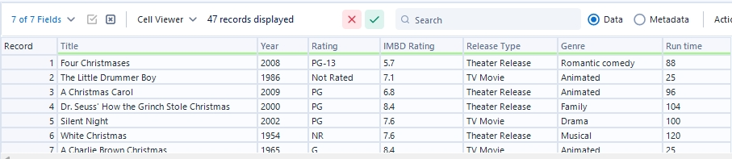
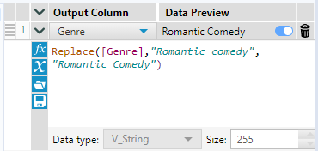
Task 3: Choosing the longest comedy movie fitting all criterions
Workflow Steps:
1. Data Cleaning: Identified and corrected a data entry issue in the "Genre" field using the Formula tool.

Slide 15
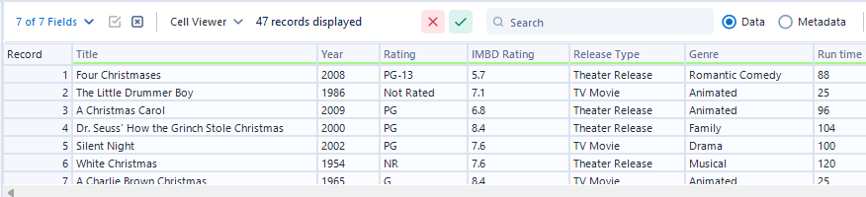
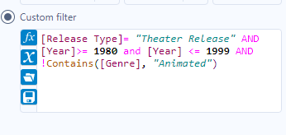
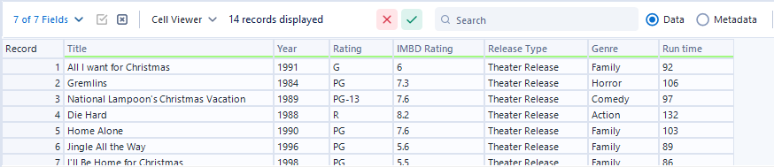
Task 3: Choosing the longest comedy movie fitting all criterions
Workflow Steps:
2. Filtering Data: Applied the Filter Data tool to exclude records that didn't meet the specified criterions.

Slide 16
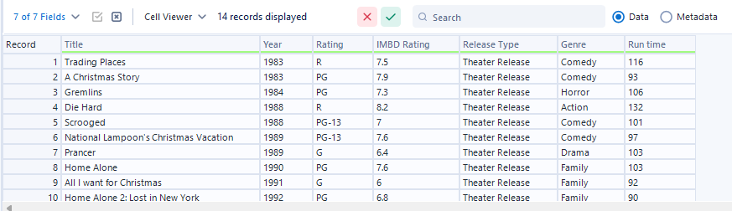
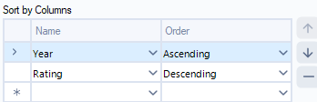
Task 3: Choosing the longest comedy movie fitting all criterions
Workflow Steps:
3. Sorting Data: Used the Sort tool to arrange the data. Sorted the "Year" field in ascending order and the "Rating" field in descending order.

Slide 17
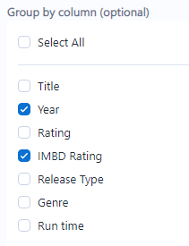
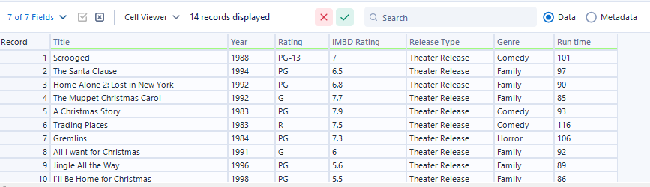
Task 3: Choosing the longest comedy movie fitting all criterions
Workflow Steps:
4. Sampling and Grouping: Used the Sample tool to group the data by the "Year" field. Extracted the highest-rated film for each year using the Sample tool.

Slide 18
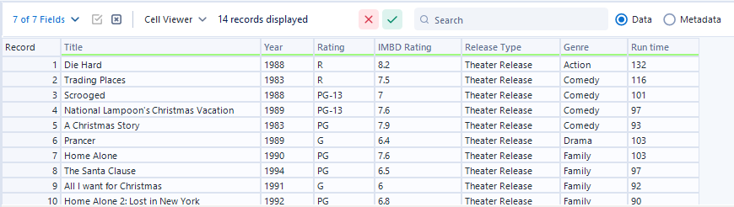
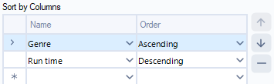
Task 3: Choosing the longest comedy movie fitting all criterions
Workflow Steps:
5. Final Selection: Used the Sort tool again to sort the "Genre" field in ascending order and the "Run time" field in descending order.

Slide 19
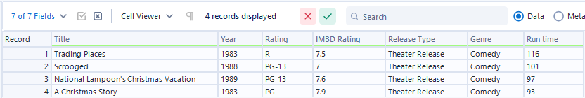

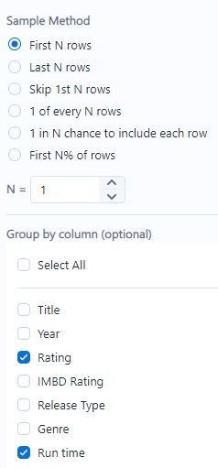

Task 3: Choosing the longest comedy movie fitting all criterions
Workflow Steps:
5. Final Selection: Select genre to “Comedy” using Filter Tool, Used Sample Tool to isolate the final answer

Slide 20
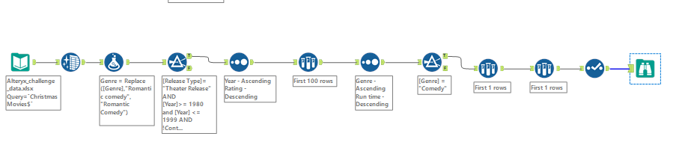

Task 3: Choosing the longest comedy movie fitting all criterions
Workflow Steps:
Result: The highest-rated Christmas film released in theatres between 1980 and 1999, in comedy genre, with longest runtime is "National Lampoon's Christmas Vacation.

Slide 21
Revisiting All the Tasks Before Proceeding:
Till now we have done 3 tasks, and the answers of all are as follows:
Task 1:
Task 2:
Task 3:

Slide 22
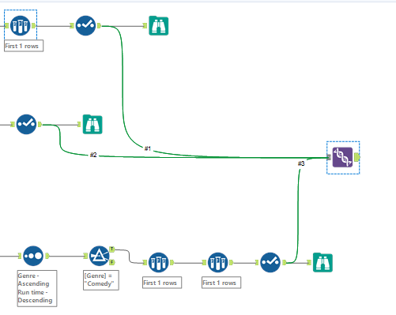
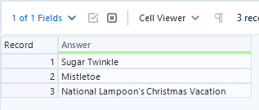
Task 4: Choosing the longest comedy movie fitting all criterions
Workflow Steps:
1. Union Tool: Used the Union Tool to stack the answers from Tasks 1, 2, and 3 into one column

Slide 23
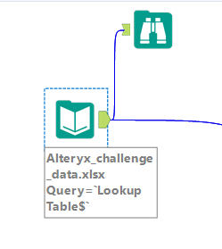
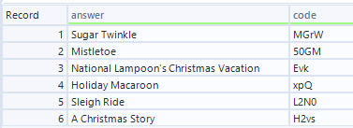
Task 4: Choosing the longest comedy movie fitting all criterions
Workflow Steps:
2. Lookup Table: As mentioned in the problem statement a lookup table was given from which we had to replace the answers with the mentioned code.

Slide 24
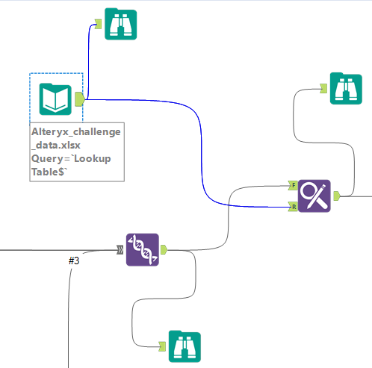
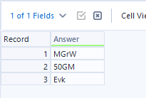
Task 4: Choosing the longest comedy movie fitting all criterions
Workflow Steps:
3. Find and Replace Tool: Matched the answers with the lookup table and replaced them with corresponding codes.

Slide 25
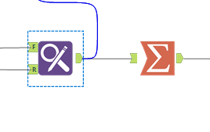

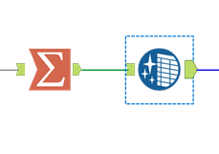
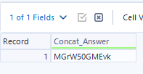
Task 4: Choosing the longest comedy movie fitting all criterions
Workflow Steps:
4. Summary Tool: Concatenated the three rows into one.
5. Data Cleansing Tool: Remove the punctuations from that one column

Slide 26
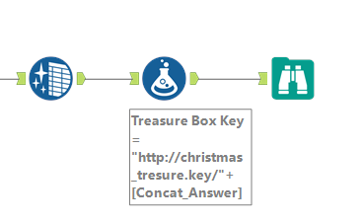
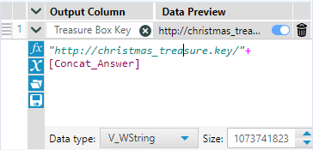
Task 4: Choosing the longest comedy movie fitting all criterions
Workflow Steps:
5. Formula Tool: Constructed the final link using the generated Concat_answer

Slide 27
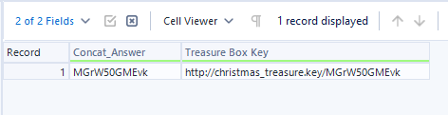
Task 4: Choosing the longest comedy movie fitting all criterions
Workflow Steps:
6. Final Link:

Slide 28
Result and Learnings:
Finally secured the treasure after a long hunt which was a link to a Christmas celebration video.
Built this workflow and learnt effective usage of multiple tools and workflow designing in Alteryx

Slide 29
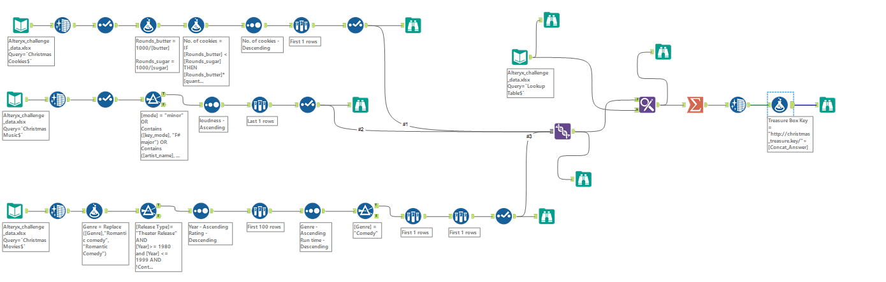
Full Workflow:

Slide 30
Thank You ☺

